Slide 1










MENTAL HEALTH& TECHNOLOGY USAGE
DATA ANLAYSIS PROJECT
Under the Supervision of Eng.Abdullah Kamal
Team
1-Ahmed Wagdy
2-Mariem Mohamed
3-Hager Saleh
4-Nouran Adel
5-Mayar Kamel
october 2024

Slide 2







AGENDA
01
Goals & Problems
02
Data sources & collect data
03
Data exploration & cleaning
04
Data merging
05
Data analysis
06
Thynk Unlimited
Data visualization

Slide 3


GOALS & PROBLEMS
GOALS:
The primary goal of analyzing data on mental health is to understand patterns and trends related to mental health with the goal of improving care, prevention, and treatment, The main objectives can be summarized in the following points:
1. Identify the causes and influencing factors.
2. Develop preventive strategies.
3. Improve diagnosis and treatment.
4. Trick the effectiveness of therapeutic programs.
5. Forecasting future needs.
6. Public awareness and policy making.
In general, the goal is to improve individuals' mental health by using the collected information accurately and effectively.

Slide 4

PROBLEMS & GOALS
PROBLEMS:
The main problem surrounding the issue of mental health is represented by several interconnected factors:
1. Lack of awareness and understanding: This lack of understanding leads to the spread of myths and misconceptions about mental health.
2. Lack of access to mental health care.
3. Lack of resources and funding.
4. Interference with other aspects of life.
5. Lack of appropriate diagnosis and treatment.
All of these factors contribute to the complexity of the mental health problem and increase the challenges that individuals and societies face in dealing with this issue.

Slide 5
DATA SOURCES & COLLECT DATA
Data collection:
1-Sources: Data was collected from two sources:
Dataset from Kaggle: contains information about technology use and mental health.
2-Google Forms Survey: Collects data on technology use, social media engagement, gaming hours, stress levels, sleep, and overall well-being.
Data size: 10163 Rows , 14 column
What problems exist in the data, such as missing data or strange values?

Slide 6
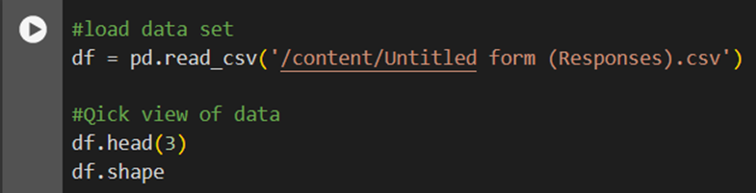
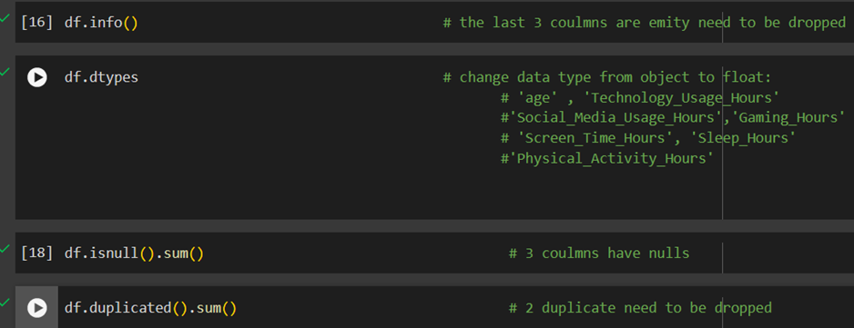
DATA EXPLORATION & CLEANING:
2. Data exploration and cleaning:
Data Exploration: Data were loaded into google colab using the Pandas library, and then checked for potential problems such as missing values ​​and outliers.
MISSION

Slide 7
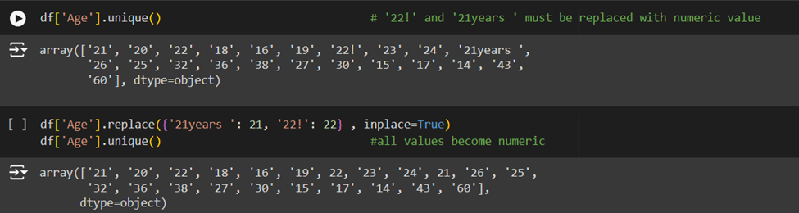
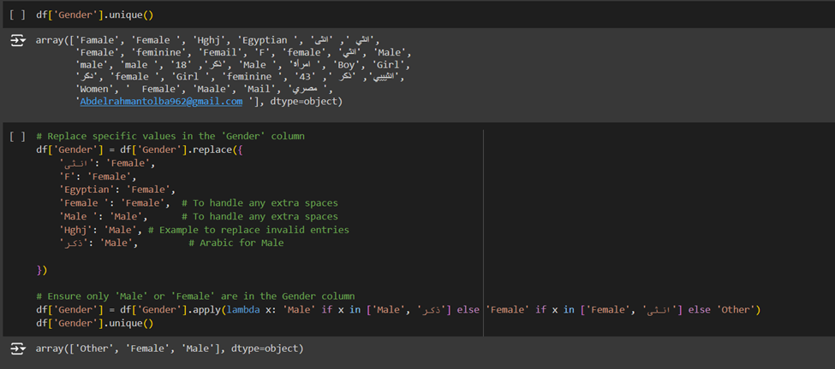
In the ‘Age’ column some of the values are string so we replace them with numeric value
o In the ‘Gender’ column some of the entered values are written in Arabic and some are numeric, so we replace these values become [ Male , Female]

Slide 8
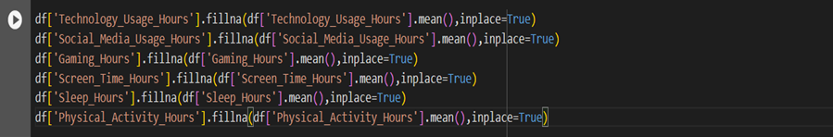
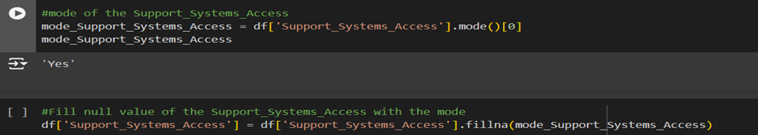
DATA EXPLORATION & CLEANING:
2. Data exploration and cleaning:
Dealing with missing values:
1.Missing values ​​in numerical columns were replaced with mean values.
2.Missing values ​​in categorical columns were replaced with the most frequently occurring value (mode).

Slide 9
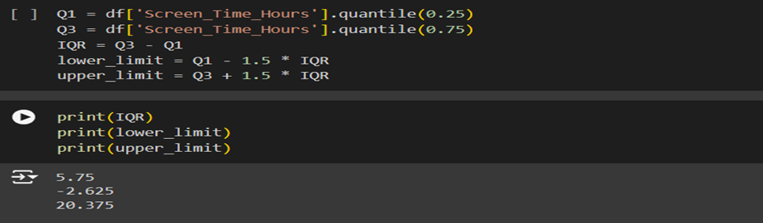
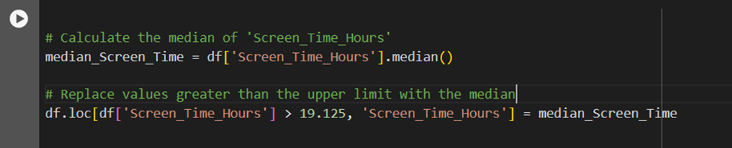
DATA EXPLORATION & CLEANING:
2. Data exploration and cleaning:
2.Dealing with outliers:
1.The IQR (Interquartile Range) was calculated and the maximum and minimum acceptable values ​​were determined.
2.Values ​​that exceeded the limits were replaced with the median.
3.Handling data duplication: Duplicate data has been removed to improve quality and accuracy.
Google Colab Notebook link :
www.reallygreatsite.com
www.reallygreatsite.com

Slide 10
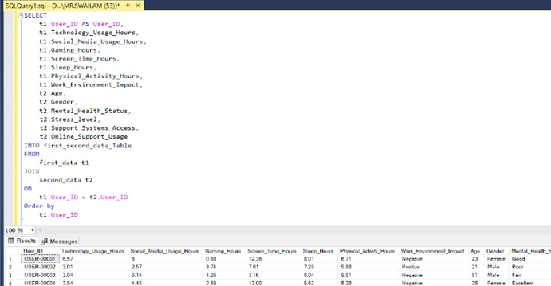
DATA MERGING
SQL was used to combine datasets from different sources. The tables were linked based on shared user IDs, which helped create a complete data set ready for analysis.

Slide 11
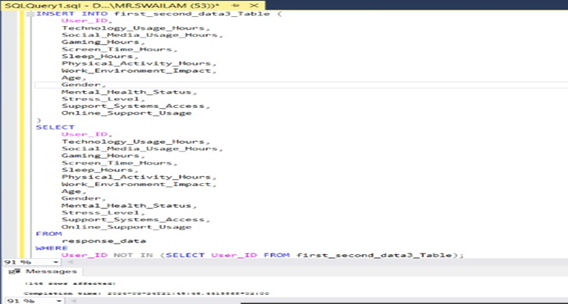
DATA MERGING
o The SQL query combines data from two tables into a single table by first inserting data from the first table and then updating the combined table with data from the second table for users who are not already included. The resulting table can be used for further data analysis and insights into user behavior patterns.

Slide 12
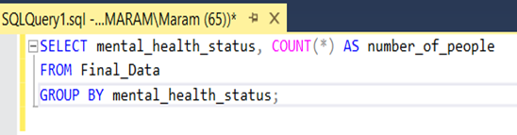
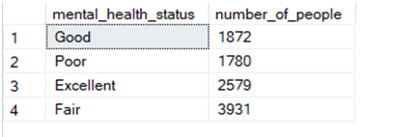
DATA ANALYSIS
SQL queries were used to extract insights into the relationship between mental health and technology use. For example:
Analysis of the distribution of individuals by mental health categories.
The impact of stress levels and the work environment on mental health.
The relationship between the number of hours of sleep and mental health.

Slide 13
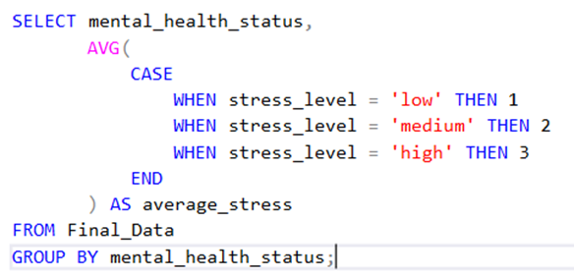
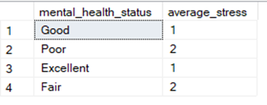
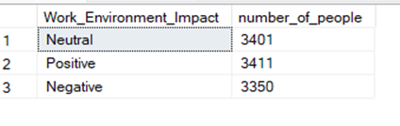
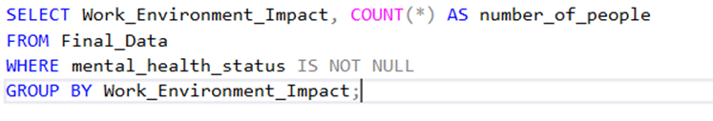
DATA ANALYSIS

Slide 14

QUESTIONS
1-What is the most useful insight in data ?
2-Is the data revolving around specific something ?
3. What is the number of people in the mental health status categories?
4. What is the number of each age interval in mental health status categories?
5. How do stress levels impact mental health status?
6. How does the work environment impact mental health status?
DATA VISUALIZATION
Tableau was used to create interactive dashboards to display key findings.
Panel 1: The impact of stress and the work environment on mental health.
Panel 2: The relationship between the number of hours of sleep, stress, and mental health.
Link To The dashboard :
www.reallygreatsite.com

Slide 15

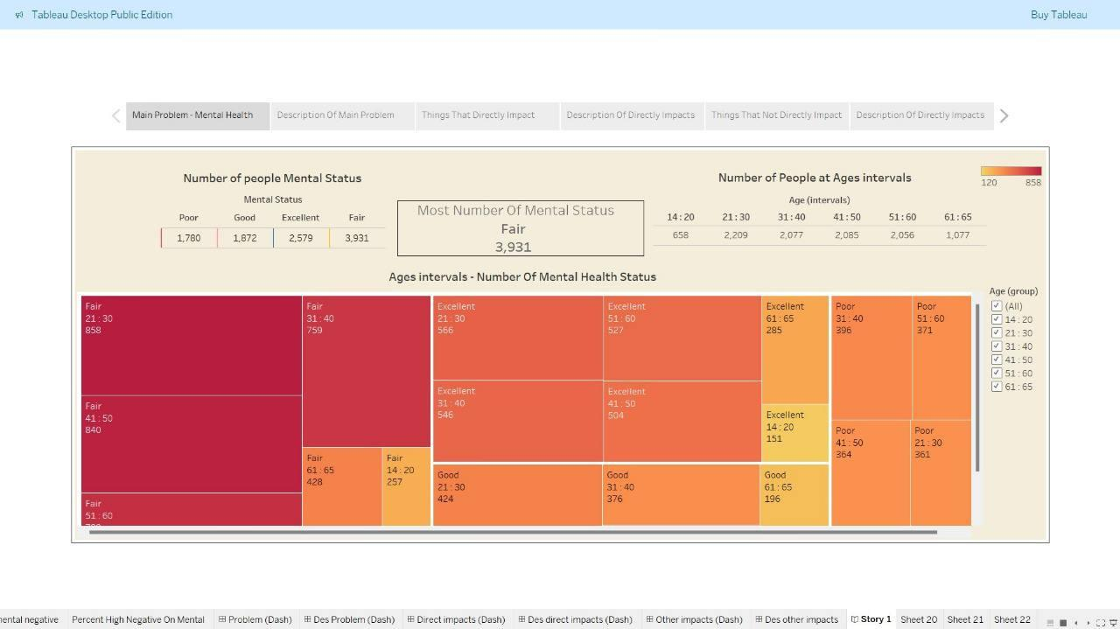
What is the number of people in mental health status categories ?
What is the number of each age interval people according to mental health status categories?

Slide 16
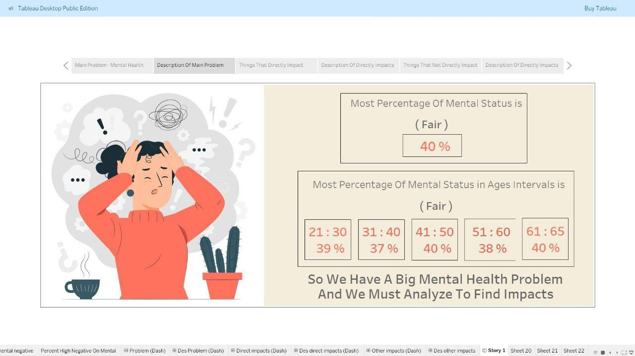

Slide 17
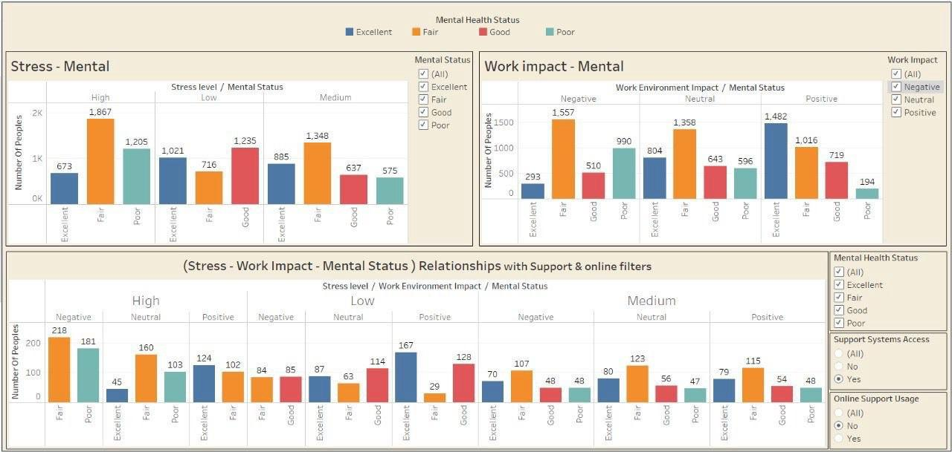
Which things impact on mental health status?
How stress levels impact on mental health status?
How work environment impact on mental health status?
Is support can resolve the problem in relationship between Stress, Work impact on mental health status?

Slide 18
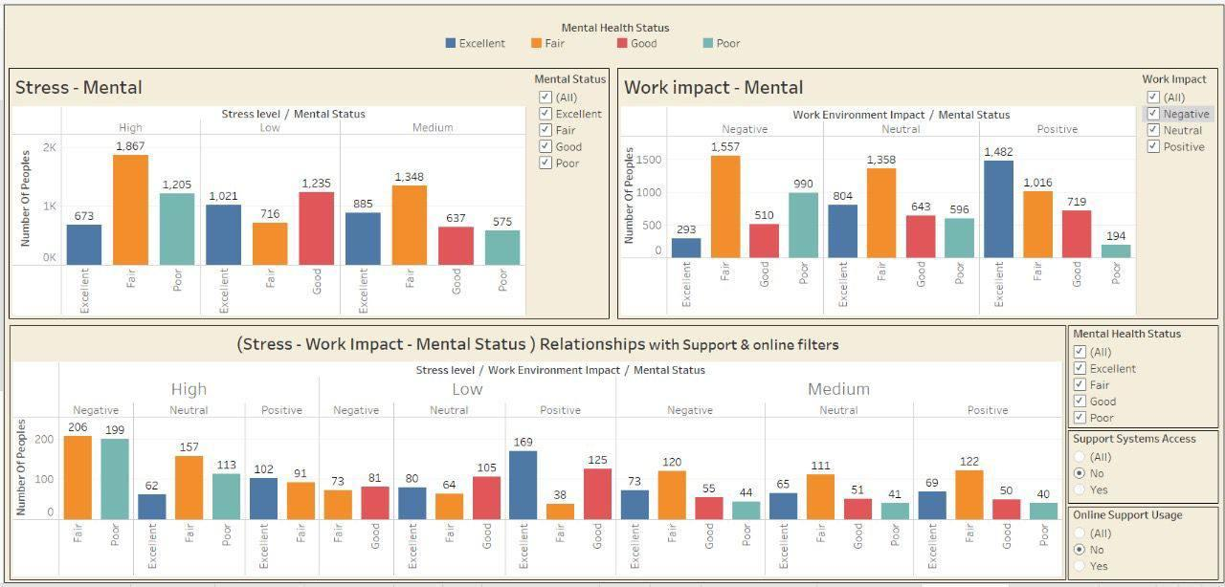

Slide 19
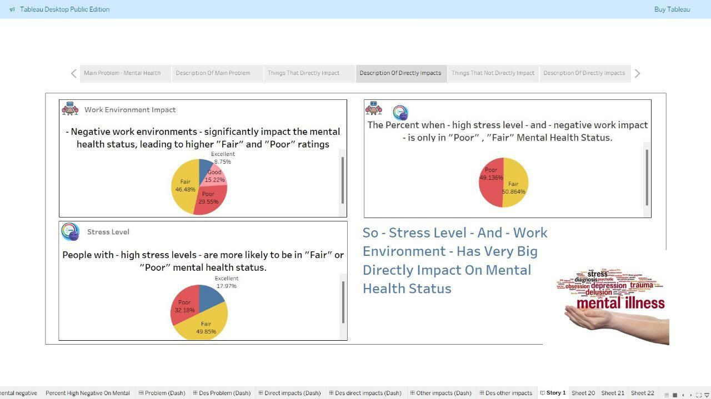

Slide 20
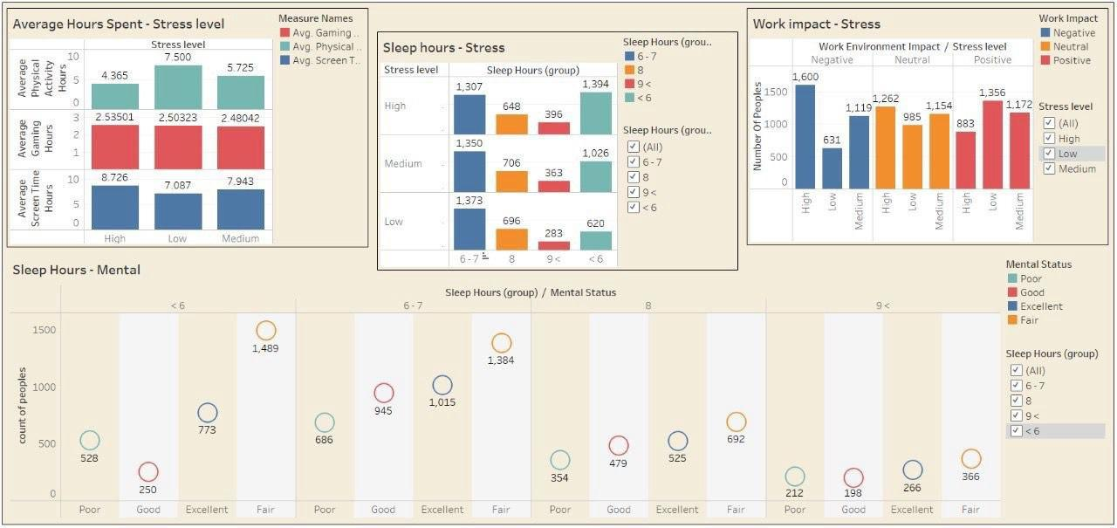
What things impact on mental but not directly which impact on things that impact directly ?
Which things impact on stress level?
Is sleep hours affect on mental health status ?
How sleep hours affect directly and not directly on mental health status?
How the average of hours spent like physical activity, screen time and gaming hours impact on stress levels?
How work environment impact on stress level?

Slide 21
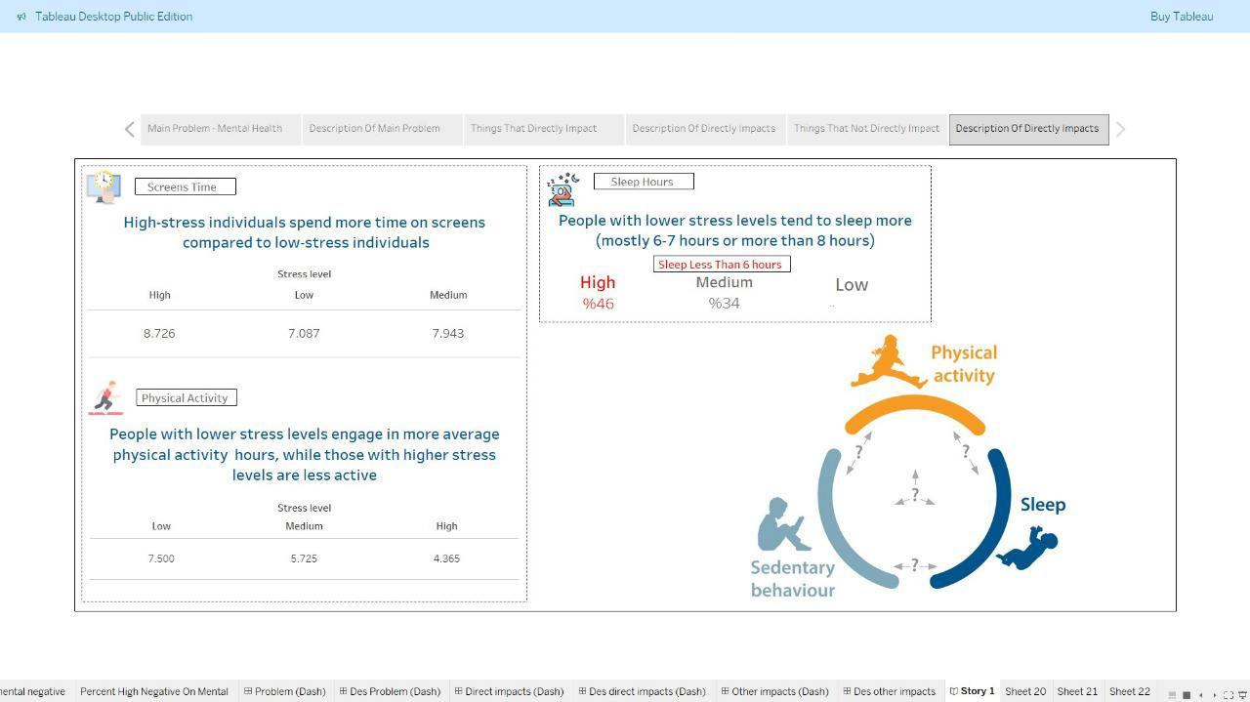

Slide 22
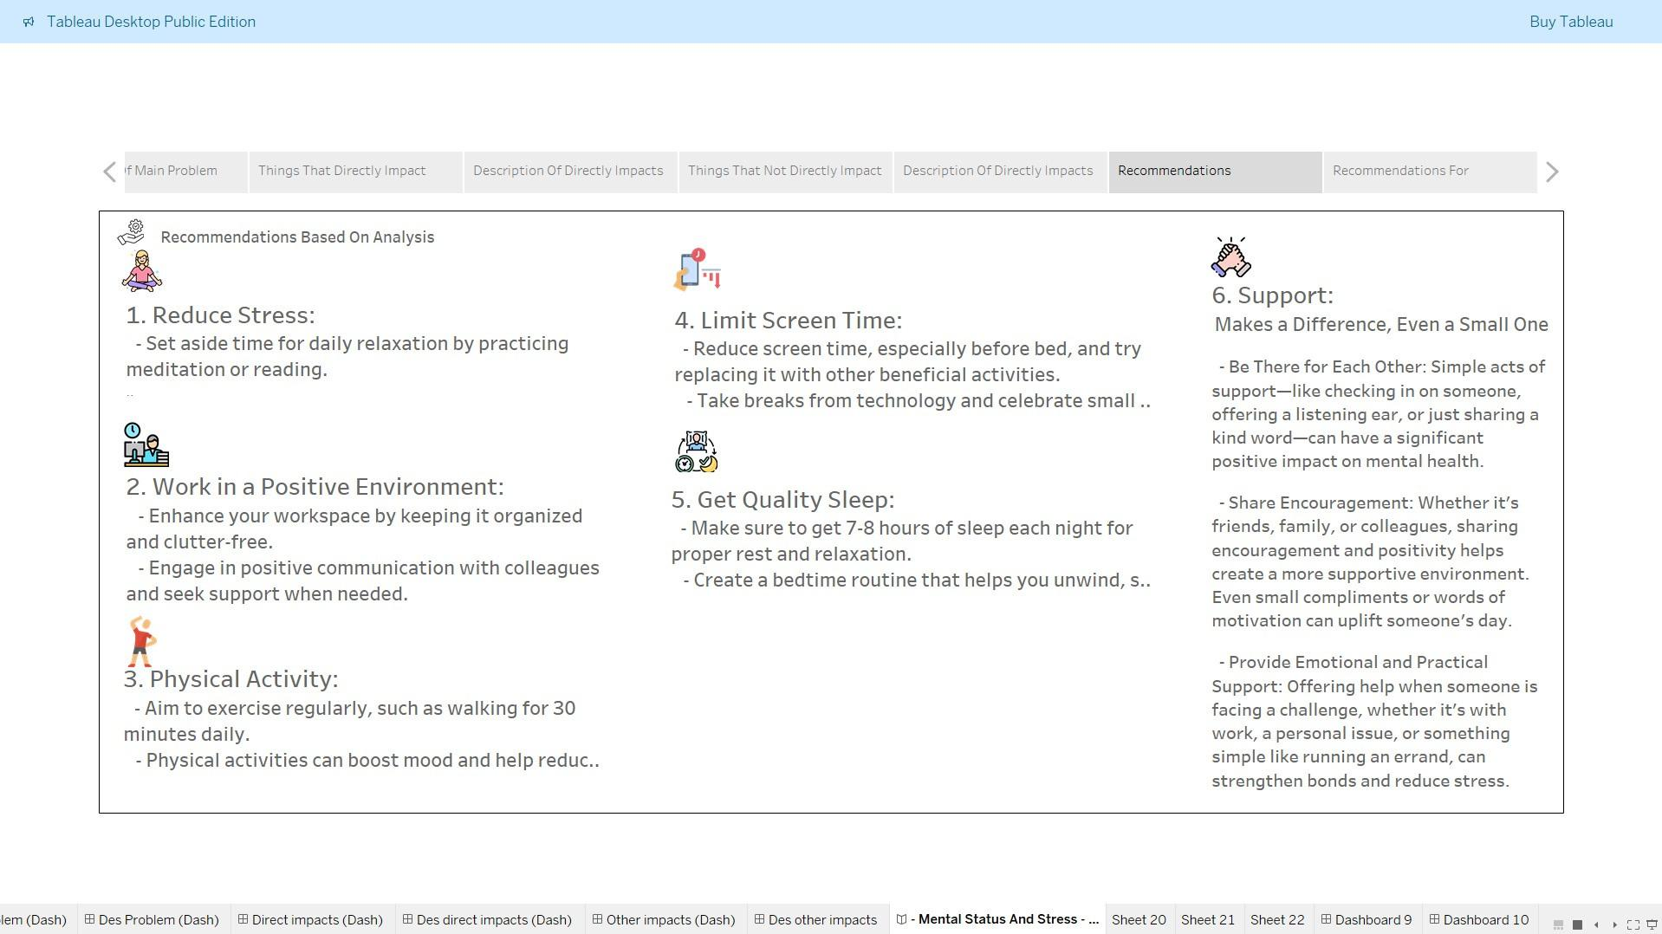

Slide 23
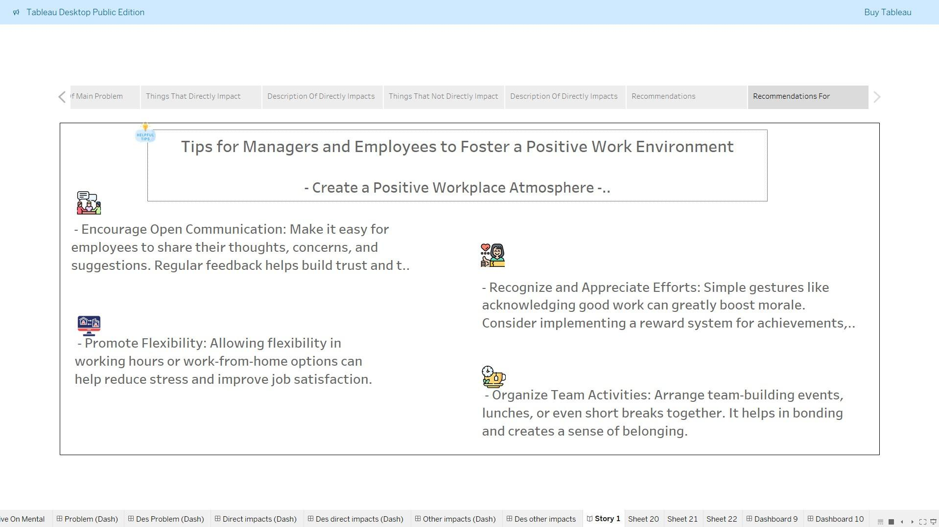

Slide 24
ANY QUESTION

Slide 25
THANK YOU

